Slide 1




HOMEOPATHIC
MEDICINE
ANALYSIS

Slide 2

INTRODUCTION
Consultancy firm assisting a client in opening a homeopathic medicine store.
Database with two essential tables for medical information.
Goal: Develop an interactive dashboard for client use.
Dashboard Insights:
Number of medicines categorized by benefit areas.
Price ranges analysis.
Brand specialization overview.
Ingredient analysis for medicines.
Average cost estimation for ingredients.
Identification of highly-rated medicines.
Purpose: Enable the client to select the best medicine for store

Slide 3
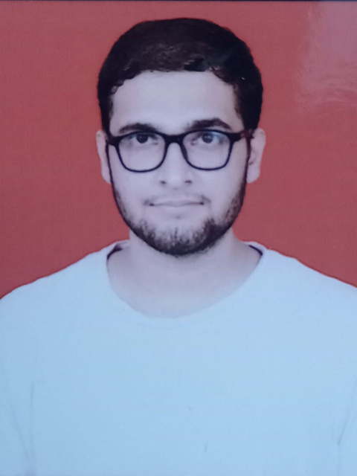
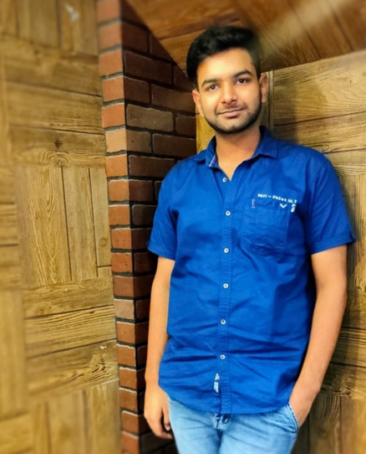
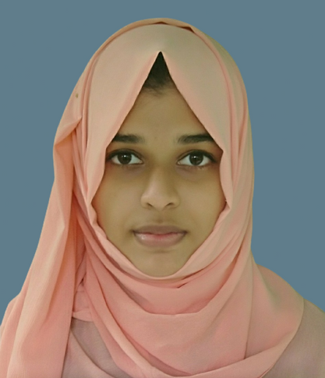
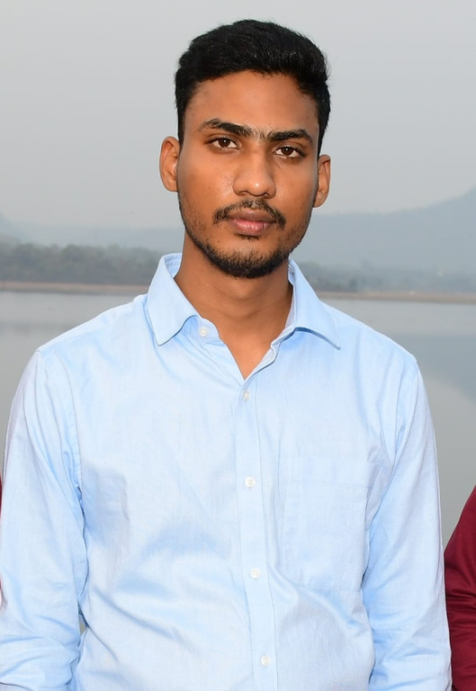
MEET OUR TEAM
NITIN CHANDRA
LAKSHAY BANSAL
FARZEENA P A
MAHBOOB ALAM

Slide 4
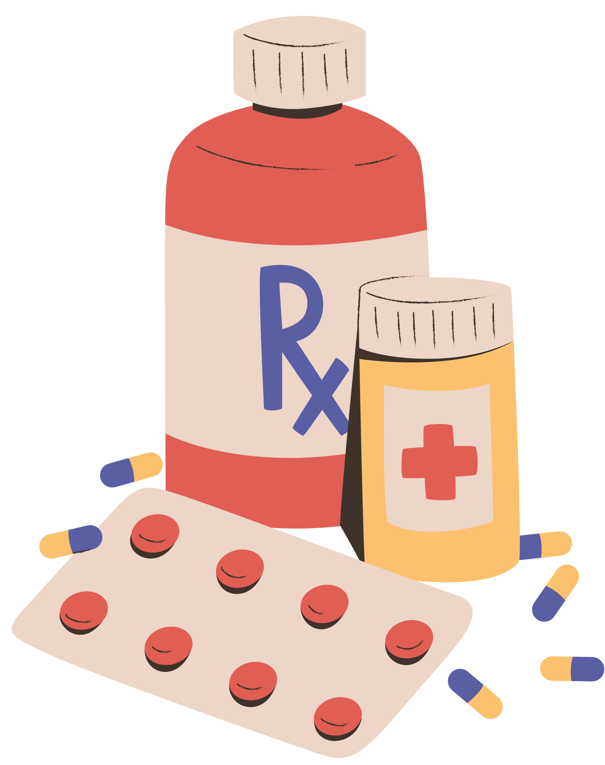
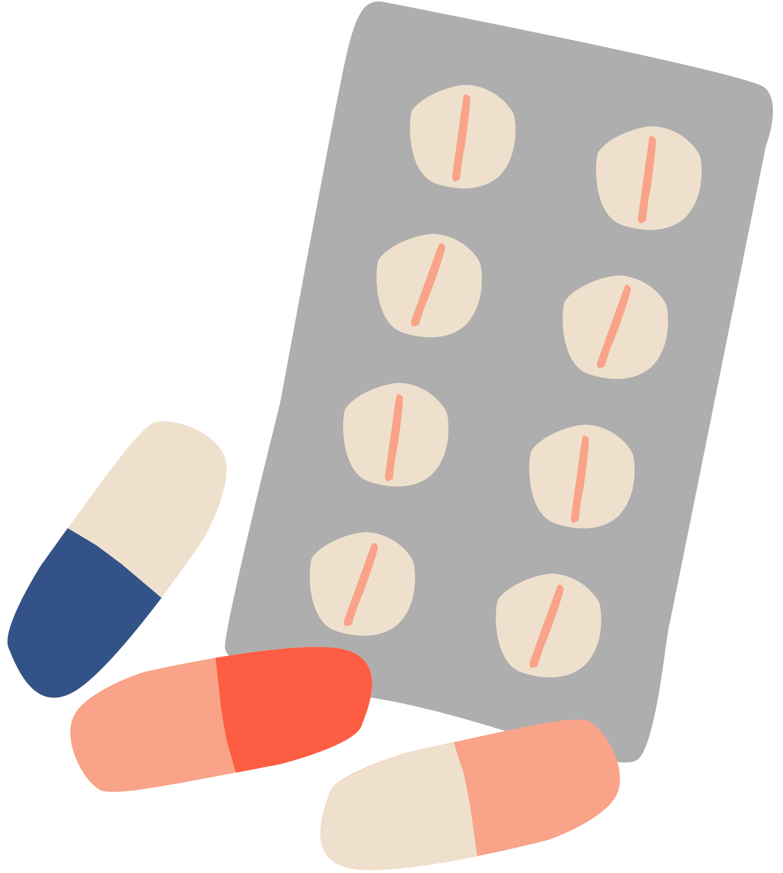
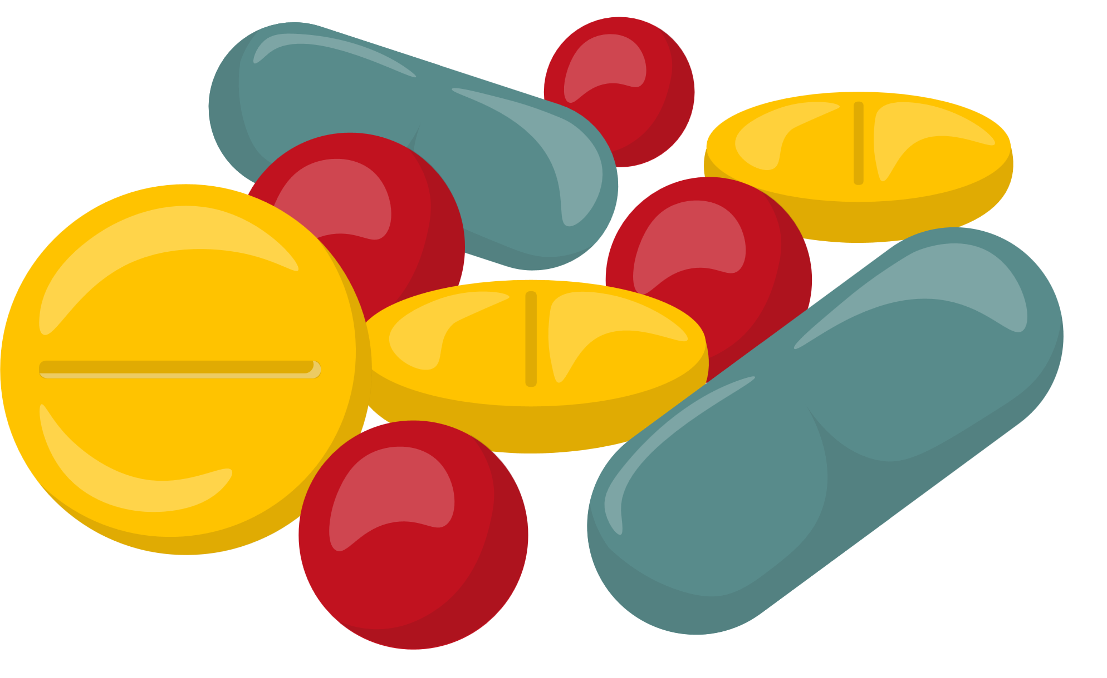
PROJECT EXECUTION
SCRAPPING (USING PYTHON & BEAUTIFUL SOUP
ANALYSIS & FILTERING
PRESENTAION

Slide 5

INSIGHTS
•Most sold medicine - Bakson’s Fevo Aid Syrup
•Most used ingredient – Lycopodium Clavatum
•Most common specific area – Eyes
•Most reviewed brand – SBL Private Ltd
•Average MRP of medicine – RS 181
•Average cash generation per sale – RS 163

Slide 6
count
25,000
20,000
15,000
10,000
5,000
0
Others
Eye
Joints
Skin
Throat
Heart
Head
Kidney
Hair
Nerves
Brain
Whole Body
Stomach
Intestine
Pancreas
Number of medicine available of different benefit area.

Slide 7
Nerves
2.7%
Eye
16.8%
Hair
4.2%
Kidney
4.9%
Head
5.1%
Joints
13.5%
Stomach
5.9%
Heart
7.3%
Whole Body
11.4%
Throat
9.7%
Skin
11.2%
Maximum number of times ingredient used in each benefit area..

Slide 8

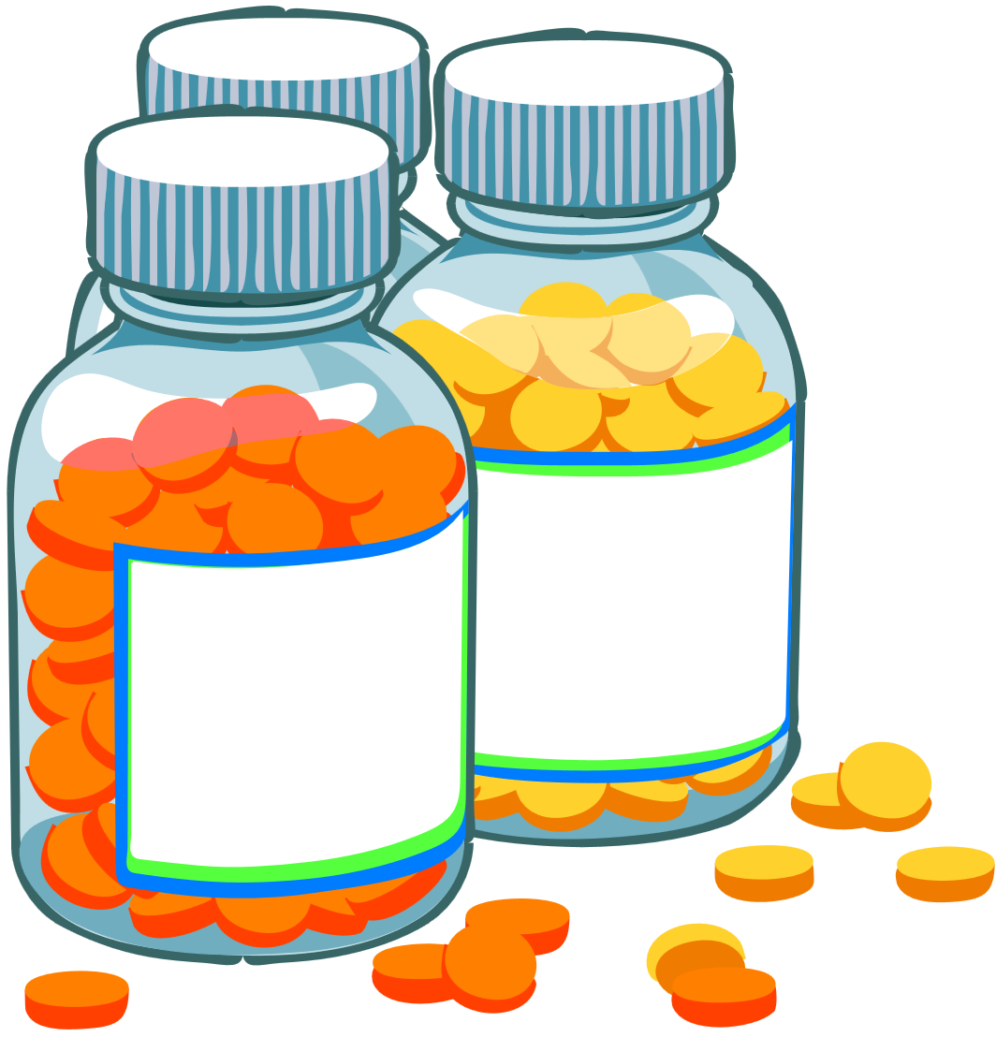
Our approach toward the Analysis
Sale Insights:
Higher sales of throat and Eye medicines indicate potential pollution or high population density areas, e.g., Mumbai and Delhi.
Inventory Strategy:
Consider stocking a significant inventory in areas like Mumbai and Delhi due to the high demand for throat and eye medicines.
Urban Market Preferences:
Metropolitan cities (e.g., Mumbai, Bangalore, Chennai) with a corporate youth population tend to prefer ayurvedic ingredient-based medicines, so factor this into store offerings.
Western States Focus:
In states like Gujarat and Rajasthan, where a majority are vegetarians, prioritize natural medicines in the inventory.

Slide 9

Northern States Approach:
Northern states like Haryana and Punjab prefer homemade desi remedies (dadi ke nuskhe), so focus on creating brand awareness and value in these regions.
Brand Impact and 1mg:
Highlight the success of 1mg, especially since it's a part of the TATA group, as an example of a company doing well across different regions.
Revolutionary Change:
Acknowledge the positive impact of companies like 1mg in revolutionizing doorstep medical services, emphasizing the importance of such services in the industry.

Slide 10
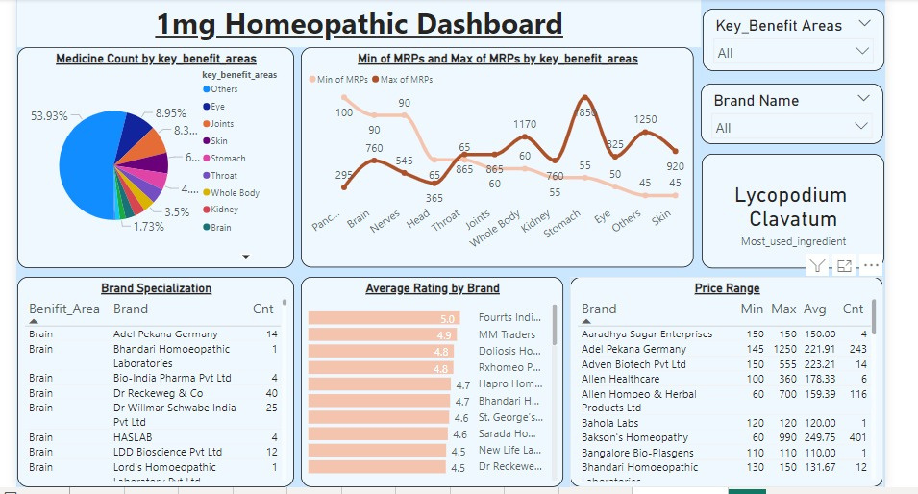
DASHBOARD

Slide 11



CHALLENGES FACED
CHALLENGES FACED DURING THE PROJECT:
LEARNING OF A NEW SKILL: WEB SCRAPPING (OPPORTUNITY AS WELL AS A CHALLENGE)
TIMING: SOME OF THE MEMBERS OF OUR GROUP WERE WORKING PROFESSIONALS AND SOME WERE FULL-TIME STUDENTS COLLABORATING AT A PARTICULAR TIME WAS A BIT OF A CHALLENGE.
DATA WAS TOO BIG TO RETRIEVE WE GOT DISCONNECTED FROM THE COMPANY’S SERVER A NUMBER OF TIMES.
REQUIREMENT OF A STABLE NETWORK.
FACE OFF WITH A REAL-LIFE PROJECT WAS CHALLENGING BUT GOT OUR HANDS ON THE TOOLS WELL.

Slide 12
THANK YOU

